Slide 1

Heart Disease Prediction using Logistic Regression
Leveraging Logistic Regression for Early Diagnosis
By - Chirandip Roy

Slide 2

Introduction: The Urgency of Early Detection
Heart disease remains a leading cause of mortality worldwide. Early and accurate detection is crucial for improving patient outcomes and significantly reducing fatal events.
Global Health Crisis
Early Detection is Key
ML for Insights
Heart disease is a primary cause of death globally.
Timely diagnosis drastically improves survival rates.
Machine learning uncovers hidden patterns in complex medical data.
Our objective is to develop a robust predictive model that accurately classifies patients as having or not having heart disease using machine learning techniques.

Slide 3
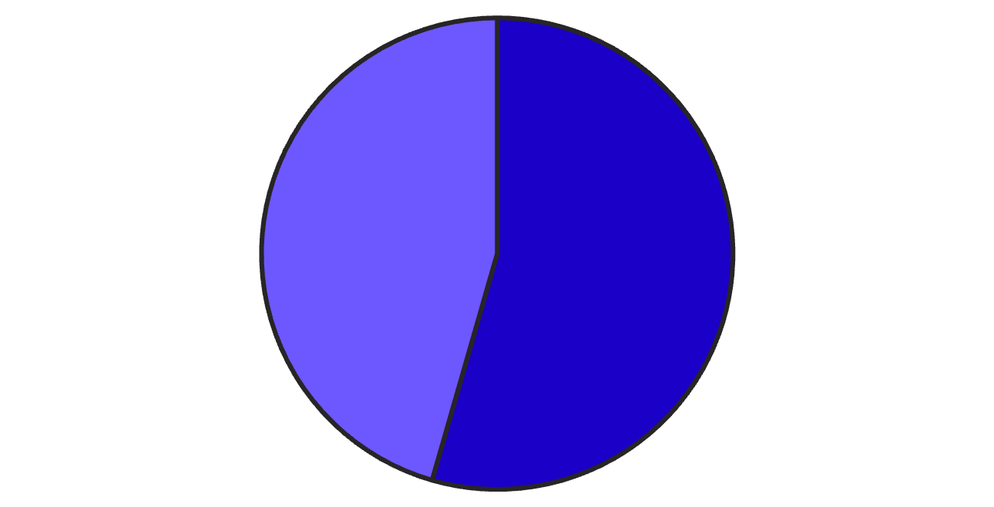
Dataset Overview: Understanding Our Data
Our predictive model is built upon a comprehensive heart disease dataset. This dataset provides critical information necessary for identifying key indicators of cardiac health.
Source: dataset_heart.csv
Shape: (303 rows, 14 columns) - providing a solid foundation for analysis.
Key Features: Age, Sex, Chest Pain Type (CP), Resting Blood Pressure (trestbps), Cholesterol (chol), Fasting Blood Sugar (fbs), Resting Electrocardiographic Results (restecg), Maximum Heart Rate Achieved (thalach), Exercise Induced Angina (exang), Oldpeak (ST depression induced by exercise relative to rest), Slope of the peak exercise ST segment, Number of Major Vessels (ca), Thalassemia (thal).
Presence
Absence
The pie chart illustrates the distribution of our target variable, showing a balanced representation of patients with and without heart disease, which is ideal for model training.
Target Variable: heart disease (1 = presence, 0 = absence).

Slide 4





Data Preprocessing: Preparing for Prediction
Effective data preprocessing is fundamental to building an accurate machine learning model. This phase ensures our data is clean, consistent, and optimally formatted.
Clean Data
Identified and removed duplicate entries, and addressed any missing values to ensure data integrity.
Encode Categories
Converted categorical features into numerical representations for machine learning compatibility.
Normalize Features
Applied StandardScaler to standardize feature ranges, preventing dominance by larger values.
Split Data
Divided the dataset into an 80% training set and a 20% testing set for robust model validation.

Slide 5

Model Development: Logistic Regression
For our predictive task, we selected Logistic Regression, a robust and interpretable algorithm well-suited for binary classification in medical contexts.
Why Logistic Regression?
Simplicity: Easy to understand and implement.
Interpretability: Clear insights into feature importance.
Efficiency: Strong performance on diverse datasets.
Probabilistic Output: Yields probabilities for clinical thresholds.

Slide 6




Heart Disease Prediction Workflow
Our machine learning pipeline systematically processes raw data to deliver accurate heart disease predictions, ensuring each step contributes to model reliability.
Data Preparation
Collect, clean, engineer, and scale raw medical data.
Model Training
Split data and develop the Logistic Regression model.
Evaluation & Validation
Assess model performance using key metrics.
Prediction
Apply the validated model for disease classification.

Slide 7
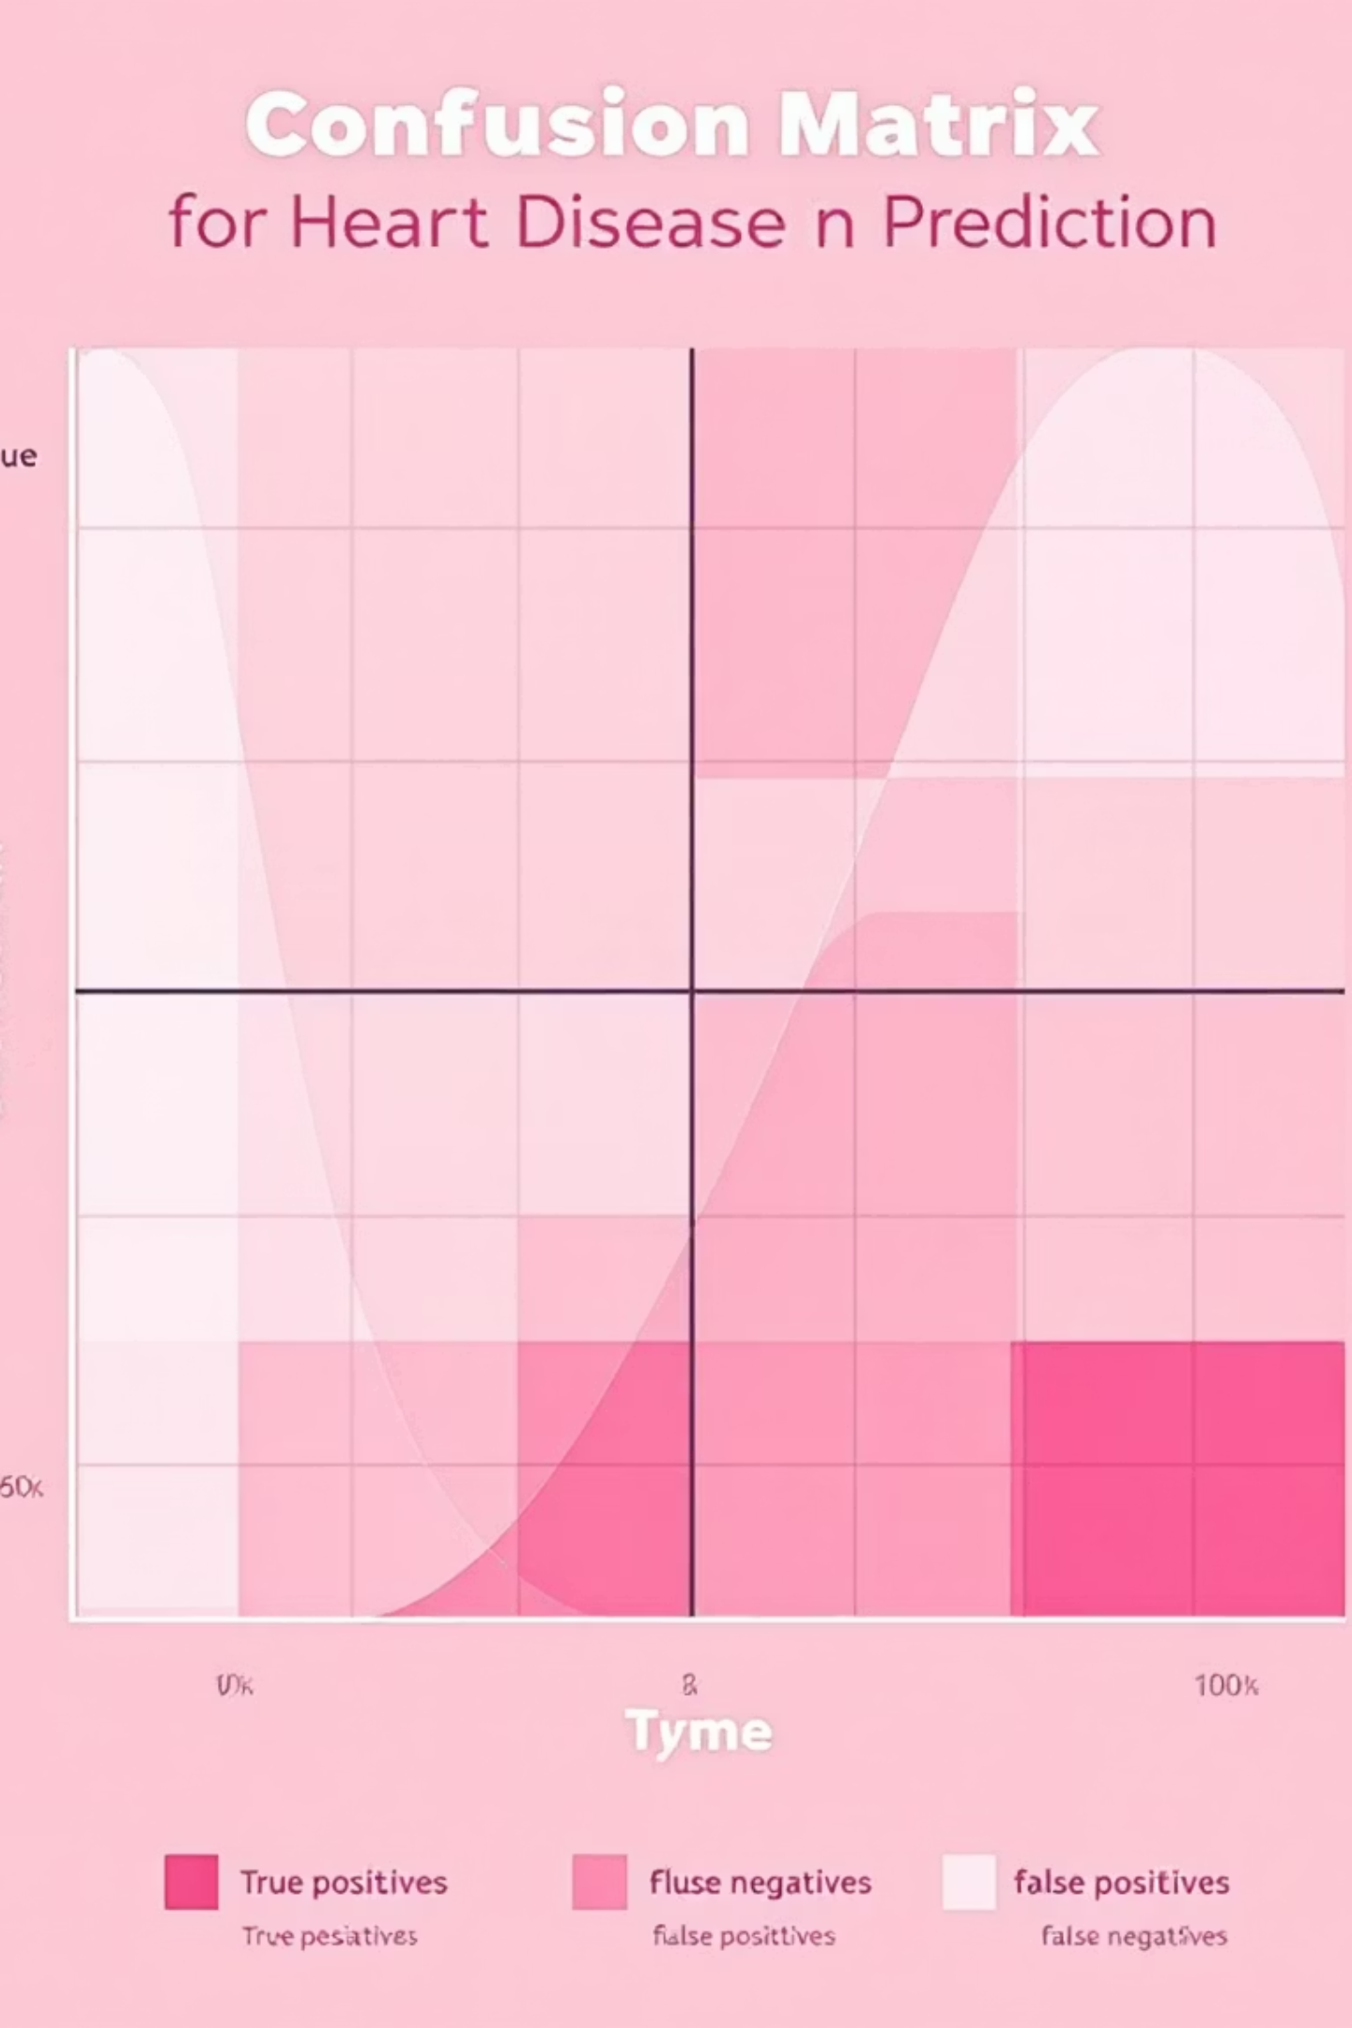
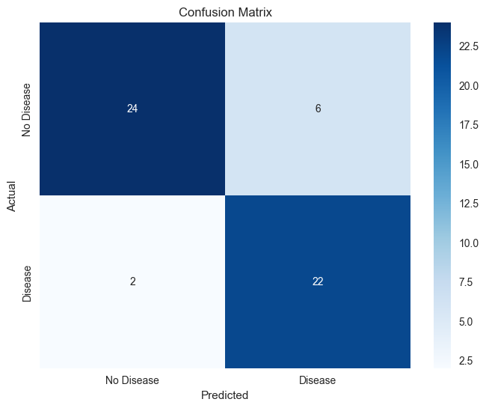

Model Evaluation: Performance Metrics
Our Logistic Regression model was rigorously evaluated using standard classification metrics to ensure its reliability and effectiveness in predicting heart disease.
88.5%
87.7%
88.7%
Accuracy
Precision
Recall
Overall correctness of the model.
Ability to correctly identify positive cases.
Ability to find all positive samples.
88.2%
F1-Score
Harmonic mean of precision and recall.
Confusion Matrix:
The model demonstrates strong performance with high accuracy, precision, recall, and F1-score, indicating its capability to effectively distinguish between patients with and without heart disease.

Slide 8
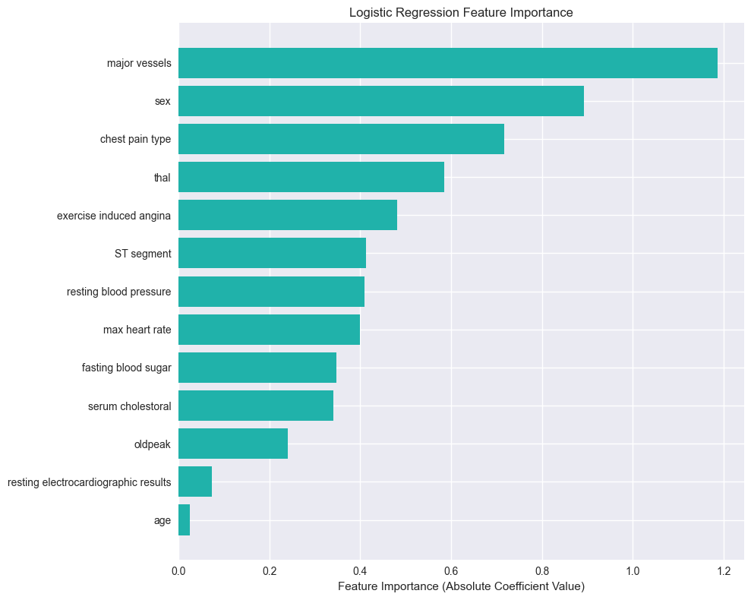
Results & Discussion: Insights from Logistic Regression
The Logistic Regression model not only provided reliable predictions but also offered clear insights into the most significant factors contributing to heart disease.
Key Findings:
Most Impactful Features:
The model achieved a balanced accuracy of approximately 88.5%, indicating strong predictive power.
Major Vessels
Logistic Regression confirmed its suitability for medical data, offering both interpretability and robust performance.
Its probabilistic outputs can assist clinicians in risk assessment and patient counseling.
Sex
Chest Pain Type

Slide 9

Limitations & Future Scope
Our model has current limitations, presenting opportunities for future enhancements and broader application.
Current Limitations:
Future Enhancements:
Small dataset size.
Limited feature variety.
Advanced Algorithms
Explore Random Forest, XGBoost, Neural Networks.
Hyperparameter Tuning
Optimize for peak performance.
Cross-Validation
Implement k-fold for robust evaluation.
Larger Datasets
Integrate multi-source data.

Slide 10
Conclusion: Empowering Early Diagnosis with ML
We have successfully developed and evaluated a machine learning model capable of predicting heart disease, demonstrating its significant potential to support early diagnosis and improve patient care.
“Prevention is better than cure — powered by data.”
Model Success
Aiding Diagnosis
Continuous Improvement
Built and evaluated an effective ML model for heart disease prediction.
The model offers potential for assisting in timely and accurate early diagnosis.
Future work will focus on enhancing accuracy and usability for wider adoption.

